Slide 1
Online Tutoring System
Requirement Analysis
2013.4.3 by Li Mengdi

Slide 2
Project Overview
Requirements
Operation Environment
User Interface

Slide 3

Functional
Requirements
Project Overview
Non-Functional
Requirements
User Interface
PURPOSS:
Design an online tutoring system which could afford an efficient platform for tutors and tutees.
Through the online searching and real time chatting, they may match with each other.
Students :get help in different kinds of subjectstutors Tutors: also benefit from the tuition fee.
Independently
third-part softwares might be used: white board ， online payment sytem (PayPal).
INDEPENDENCE:

Slide 4
Functional
Requirements
Project Overview
Non-Functional
Requirements
User Interface
PROJECT SCOPE:
Shanghai Area
USER FEATURES:
i.Ultimate User:
TUTEES & TUTORS:primary/middle/high school students, or their parents, undergraduates or over educated adults.
ii.Administrator
iii.Maintainer

Slide 5

Functional
Requirements
Project Overview
Non-Functional
Requirements
User Interface
PRIMARY ACTORS:
1, Tutors
2, Tutees
3, Administrators
MAIN FUNCTIONS:
.
1, Manage Account: Tutor / Tutee
Register;
Login;
Edit Profiles;
2, Search/Match
Advanced Search : Subjects, Level, District, Gender;
Different Search Entrance;
Send Request;

Slide 6
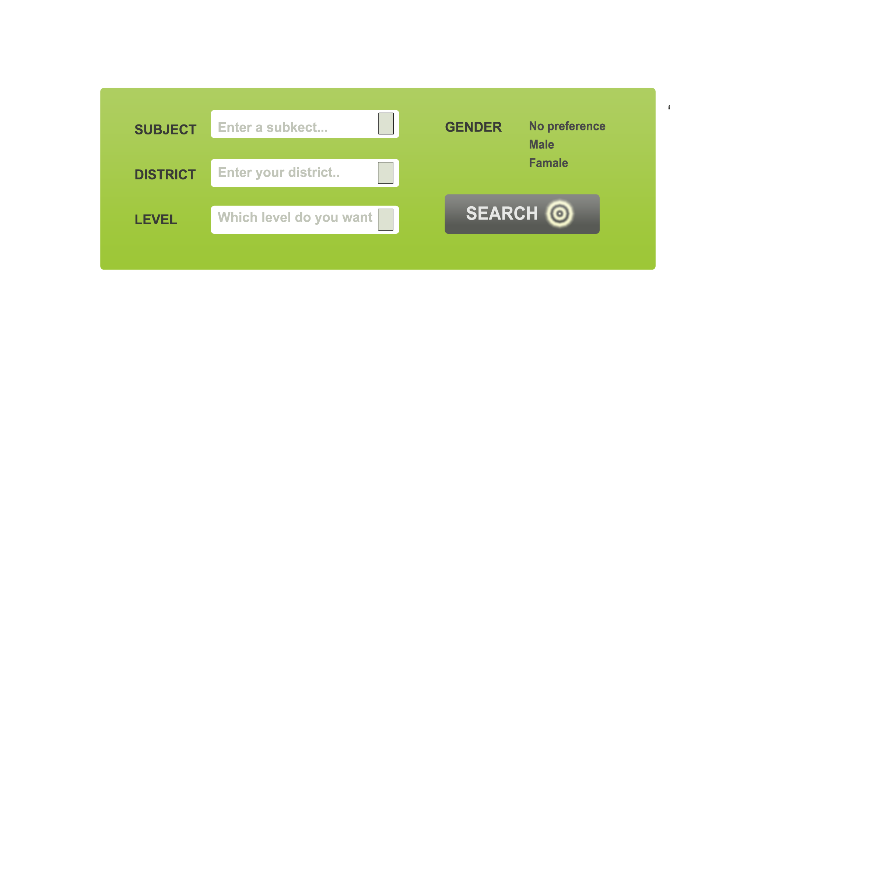
Functional
Requirements
Project Overview
Non-Functional
Requirements
User Interface
ADVANCED SEARCH

Slide 7
Functional
Requirements
Project Overview
Non-Functional
Requirements
User Interface
MAIN FUNCTIONS:
3, Real Time Chatting;
One to one
Course group
White board
4, Publish Requirement
introduce your requirement in details
both, showed on the main page
5, Upload videos/fotos/documents
showed on tutor’s personal page
or chatting room

Slide 8


Slide 9
Functional
Requirements
Project Overview
Non-Functional
Requirements
User Interface
MAIN FUNCTIONS:
6, Online Payment
Assumption: Third part software: PayPal
7, Evaluation
leave commets (tutees)
8, Feedback
report questions
BACK STAGE MANAGEMENT:
(ADMINISTRATOR)
Manage accounts;
Public Notice;
Users reporting

Slide 10

Functional
Requirements
Project Overview
Non-Functional
Requirements
User Interface
NON FUNCTIONAL:
1, Performance Requirements：
2, I/O Requirement :
data type: string, integer,video,image(PNG or JPG)
accuracy
3, Properties：security
maintenance
scalability
compatibility

Slide 11
THANK YOU !

